Slide 1
Map/Maze/Level/Room Generation
Celica Lysik

Slide 2
Goals
Create a procedurally generated map in SDL
Have the user be able to re-generate maps based on certain parameters
Could be used to make maps for roguelikes or other games that require procedurally generated maps.
https://hive.indienova.com/farm/blog/2016/12/8752-1482575101.gif

Slide 3

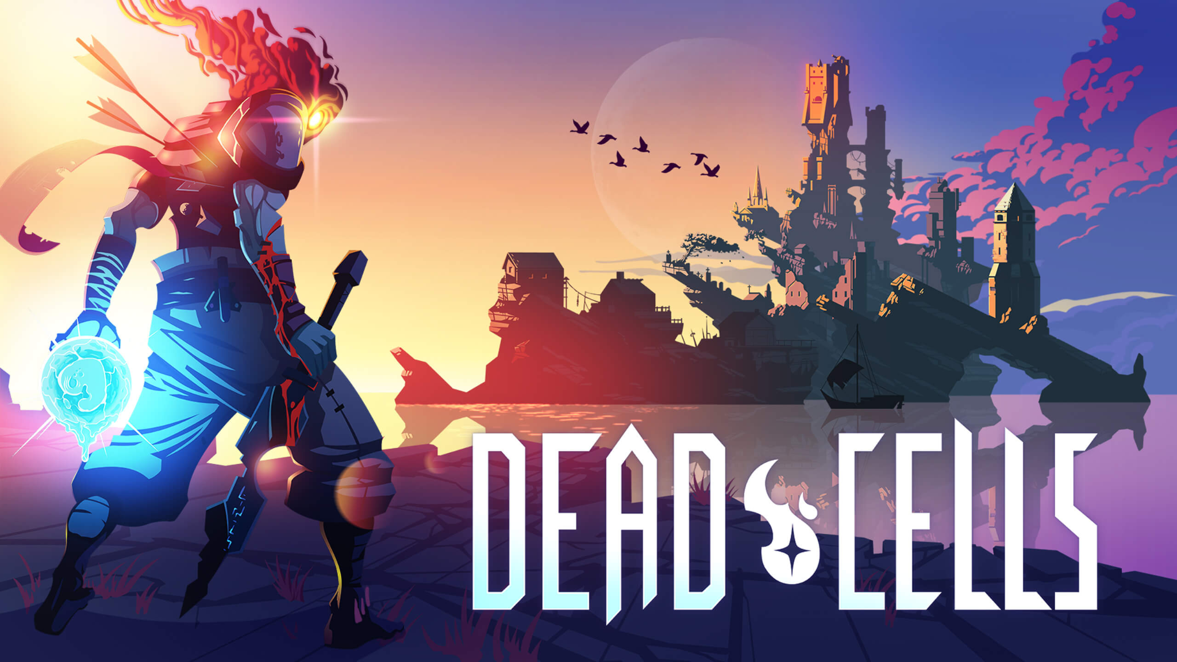
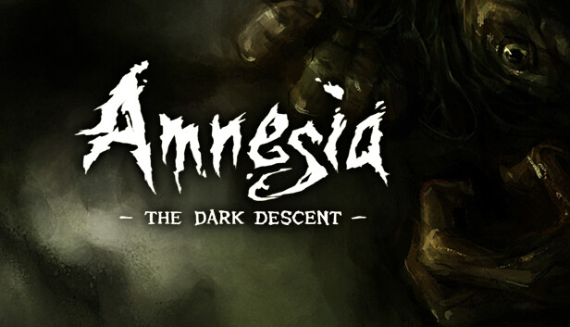
Using SDL
Initially released in 1998 by Sam Lantinga while working for Loki Software
SDL is a cross-platform development library that provides low level access to keyboard, mouse and joystick, audio, etc.
Graphics supported through OpenGL and Vulkan
Not a game engine but cool games have been made in it.

Slide 4
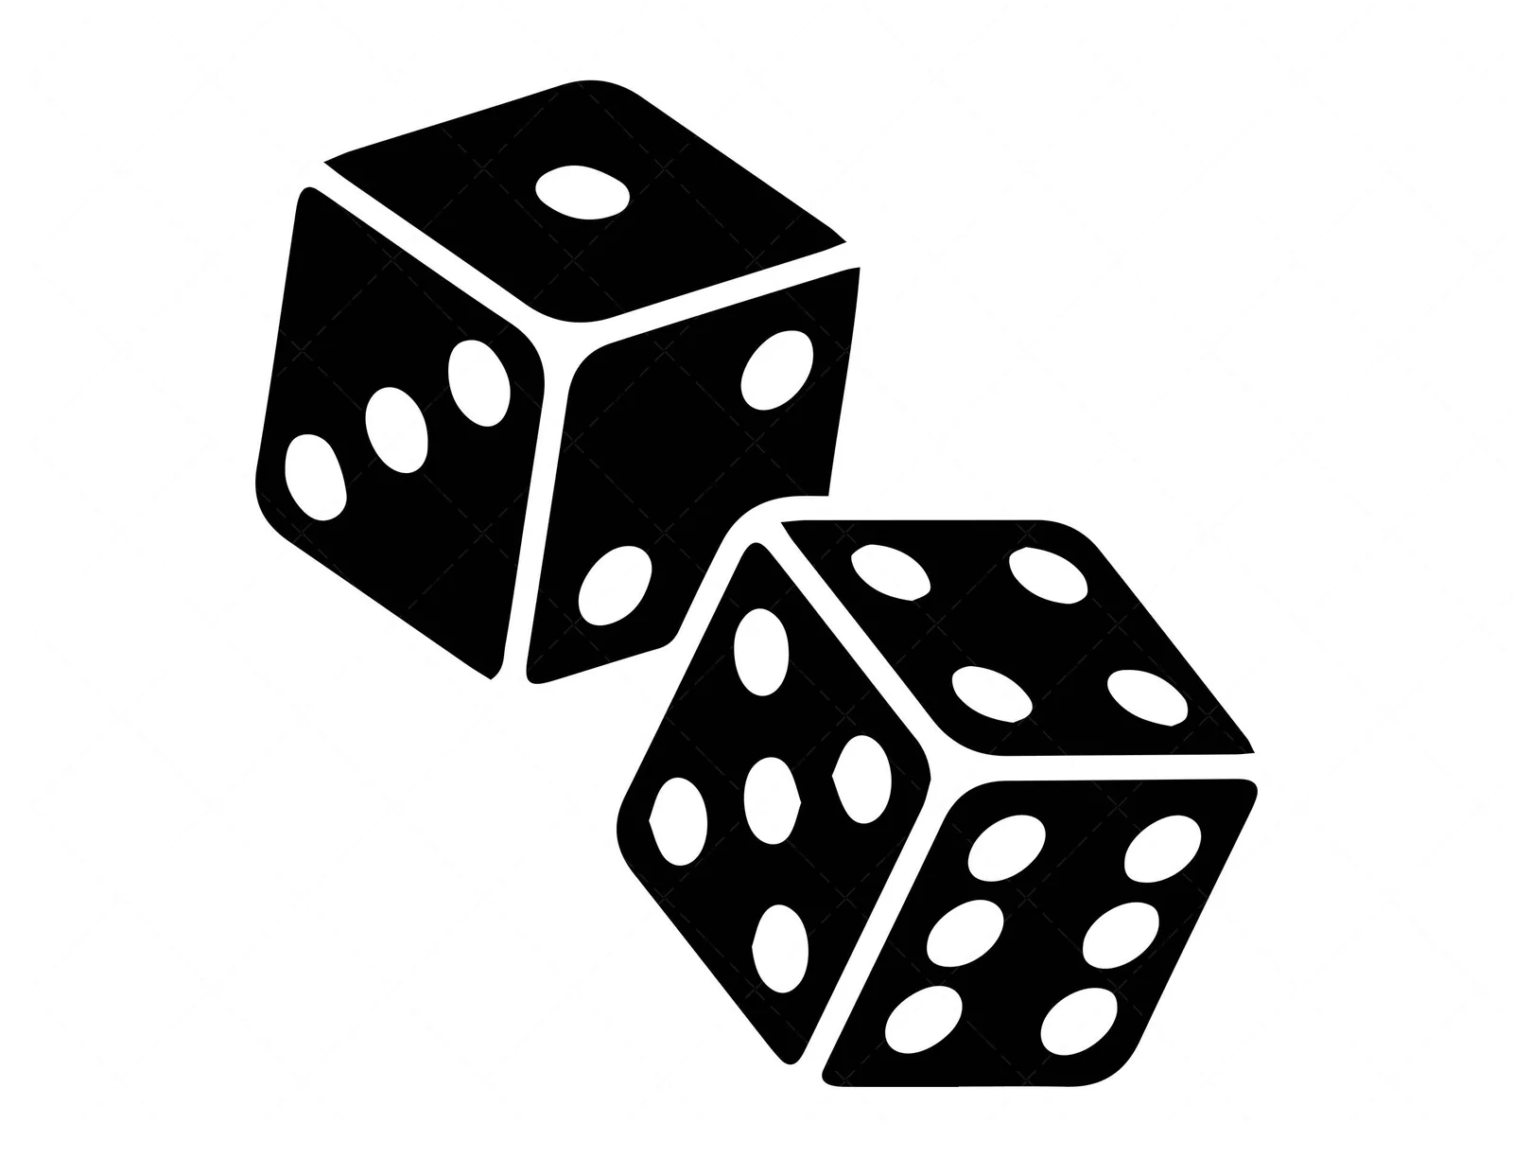
Procedural and Random Generation
Procedural Gen
Process of content creation using an algorithm
One output can be replicated using the same inputs
Random Gen
Algorithms fed different inputs/altering expressions
Pseudo randomness

Slide 5

Setup
Game
Holds data about the window, renderer,
Mostly SDL stuff
Texture
SDL image wrapper
SDL libraries
Image
font
Tile
Position
Type

Slide 6
Concept
Levels generated through “Tile Type”
Based on ruleset defined by Binding of Isaac Style Dungeon Generation Algorithm.
Determine the neighbor cell by adding (step amount) to current cell
If the neighbor cell is already occupied, end
If the neighbor cell has more than one filled neighbor, end
If enough rooms have been generated, end

Slide 7
DEMO

Slide 8
FUTURE PLANS

Slide 9
Sources
https://indienova.com/u/root/blogread/1766
https://www.boristhebrave.com/2020/09/12/dungeon-generation-in-binding-of-isaac/
https://www.libsdl.org/
https://lazyfoo.net/tutorials/SDL/index.php
https://cread.jd.com/read/startRead.action?bookId=30372452&readType=1

